Slide 1

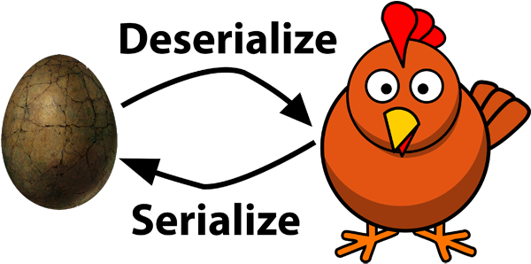
DESERIALIZATION
By Theseus aka Blu3

Slide 2

Overview
Phase 1: Basic
(De)serialization
Phase 2:
Phase 3: Demos
Phase 4: Ending

Slide 3

(De)serialize 101

Slide 4
What is (de)serialization ?
Serialization: translate data structure or object state into byte format
→ store on disk, database, or transmit over the network.
Deserialization: opposite process. Extract data structure or obj from bytes.
Object
Bytes Stream
Notes:
PHP exampple:
serialize() an object to string
write string to a file
unserialize() the file's content back into an object

Slide 5

Many name, same concept
Cover a range of languages: Object-oriented programming support serialization
PHP: serializing / unserializing
Java: serializing / deserializing
Python: pickling / unpickling
Ruby: marshalling / unmarshalling
etc

Slide 6
It’s a feature, not a bug
Deserialization across different languages will attempt to turn whatever byte stream is provided back into an object
Depending on the object, this can result:
Privilege escalation through object properties
Arbitrary code execution
Risk:
An untrusted deserialization user inputs by sending malicious data to be de-serialized → lead to logic manipulation or arbitrary code execution
Notes:
Example properties user_id = 1
Change to =0, -> root privilege

Slide 7


Slide 8

“Magic method”
Notes:
Note: with private variables -> serialize will add 2 null byte /0x0

Slide 9
“Magic method”
All function names starting with __ as "magical" → MUST be declared as public
Very useful in OOP
Automatically called when certain conditions are met.
unserialize():
__wakeup: called when an obj is deserialized
_destruct: called when PHP script end and obj is destroyed
__toString: uses obj as string but also can be used to read file or more than that based on function call inside it
serialize()
__sleep: called when an object → serialied → must be return to array.
Notes:
Note: with private variables -> serialize will add 2 null byte /0x0

Slide 10

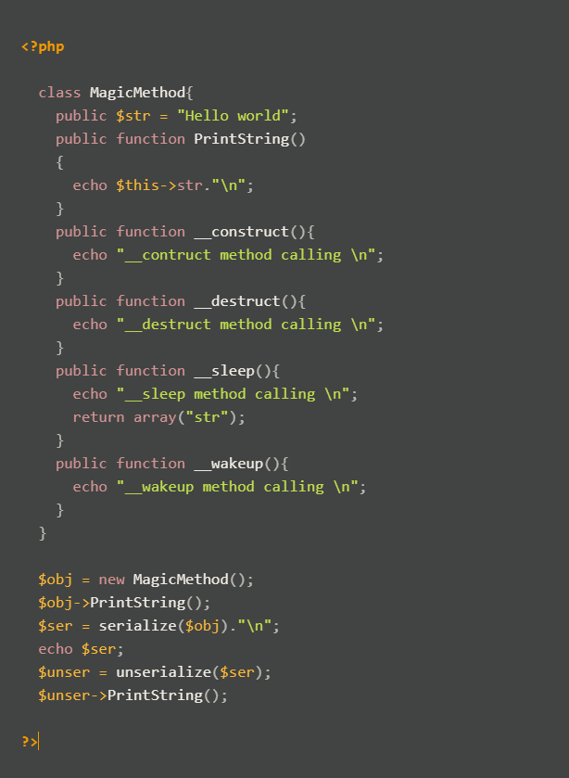
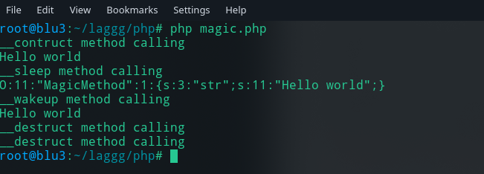
Example
Result:
O:11:"MagicMethod":1:{s:3:"str";s:11:"Hello world";}
Notes:
Explain: code flow
1. call __construct() to construct obj.
2. call __sleep() when starting serialization
3.__wakeup() when execute deserialization and also execute __destruct()
O:11:"MagicMethod":1:{s:3:"str";s:11:"Hello world";} : Object length = 11, value=MagicMethod, 1 variables { string, length name =3 = str, value pair length =11 == Hello World}

Slide 11

Exploit

Slide 12

Mitigations and CVEs

Slide 13

Mitigations:
Never use unserialize() on anything that can be controlled by a user
Use JSON method to encode/decode data: json_encode(), json_decode()
Bugs in the Wild:
CVE-2015-8562: Joomla Remote Code Excecution
CVE-2015-7808: vBulletin 5 Unserialize Code Execution
CVE-2015-2171: Slim Framework POI

Slide 14

Thanks for Reading !!!

